Slide 1
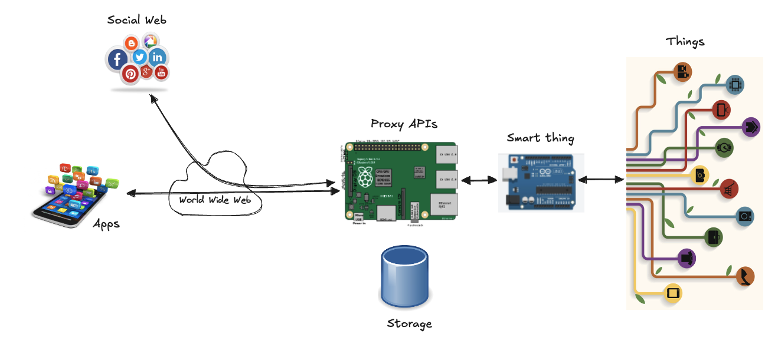
HTTP

Slide 2
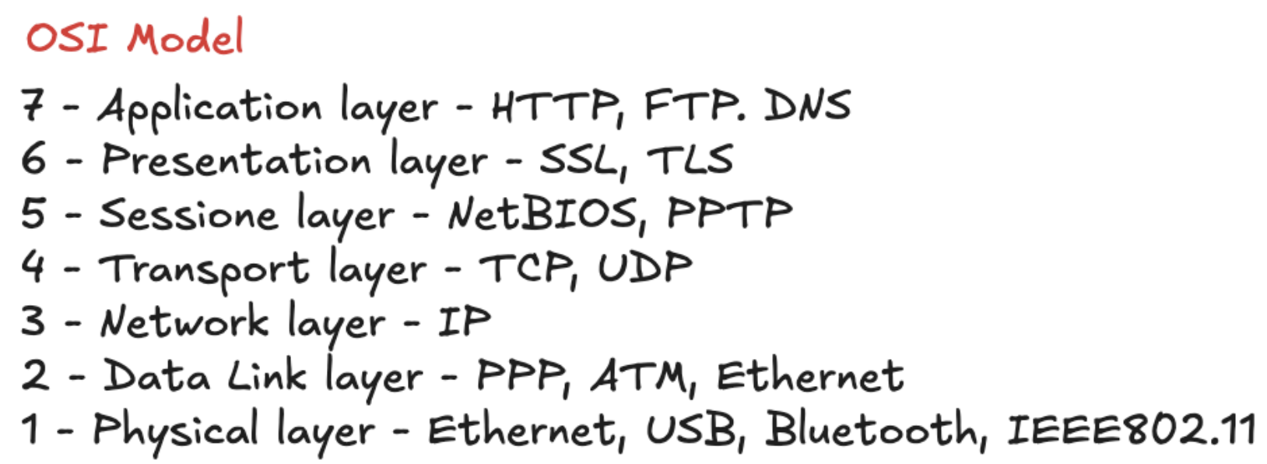
Introduction
Hypertext Transfer Protocol (HTTP)
application-level protocol
distributed, collaborative, hypermedia information systems
The foundation for data communication for the World Wide Web since 1990
HTTP is generic and stateless protocol
used for different purposes based on its request methods, error codes, and headers
Basically, it is a TCP/IP based communication protocol, used to deliver data (HTML files, image files, query results, etc.) on the World Wide Web
The default port is TCP 80, but other ports can be used as well
Provides a standardized way for computers to communicate with each other
HTTP specification:
how clients request data will be constructed and sent to the server
how the servers respond to these requests

Slide 3
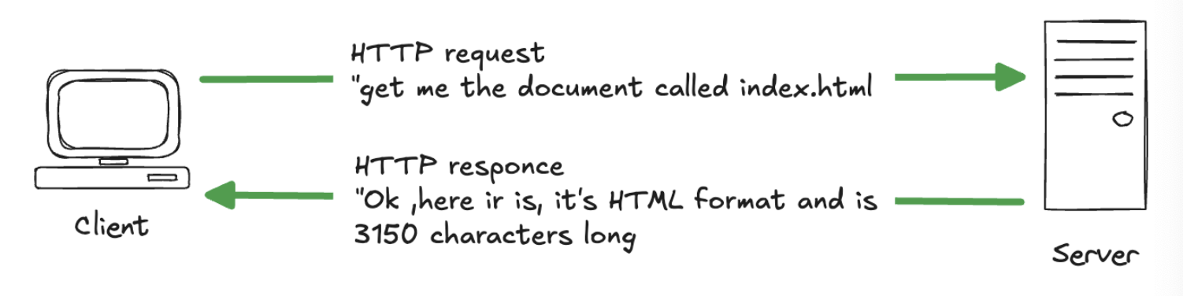
Basic features
Connectionless
client initiates requests and waits for the response
server processes the request and sends a response back
after that client disconnect the connection is closed
client and server knows about each other during current request and response only
Media Independent
any type of data can be sent by HTTP as long as both the client and the server know how to handle the data content
it is required only to specify the content type using appropriate MIME-type
Stateless
server and client are aware of each other only during a current request
afterwards, both of them forget about each other
neither the client nor the server retains information between different requests

Slide 4
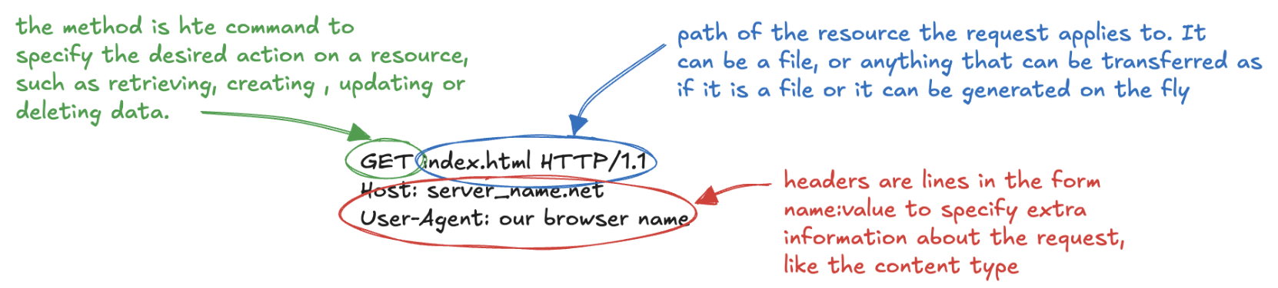
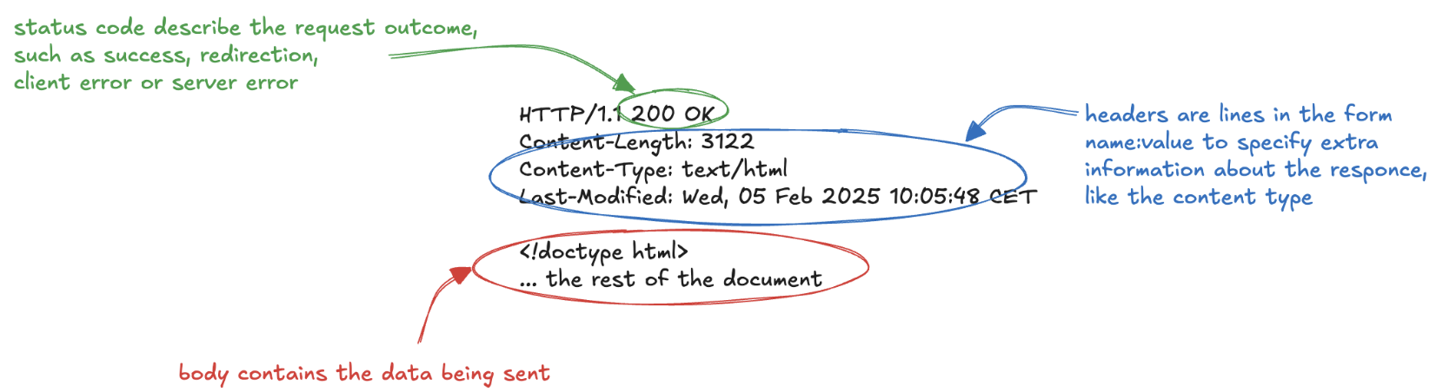
Elements
Request
Response

Slide 5
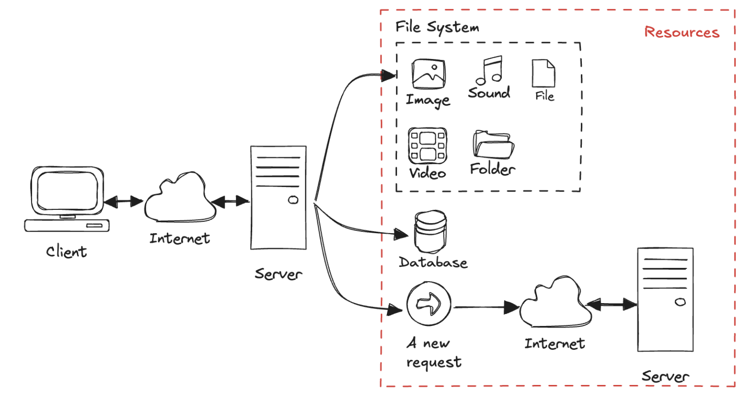
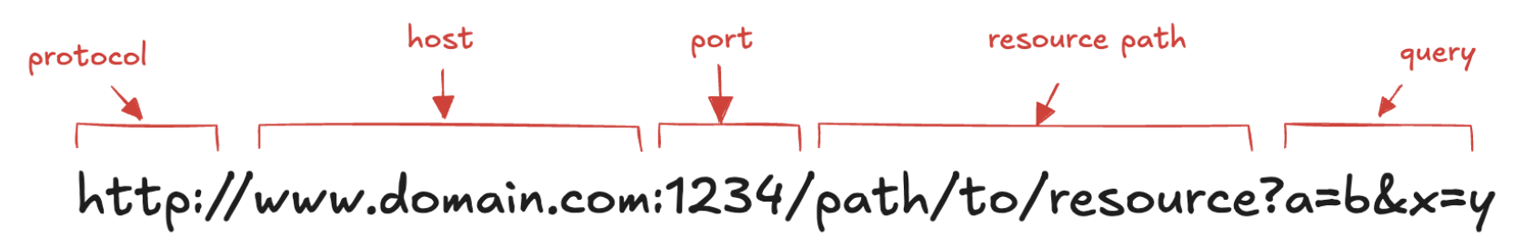
Resources, URLs and Verbs
Resource
the target of a request, which nature isn't defined further
it can be a document, a photo, or anything else!
Uniform Resource Locator (URL)
the identity of the particular resource
Verbs
the action that should be performed on the resource specified via URL
HTTP has formalized a few verbs that capture the essentials that are universally applicable for all kinds of applications
GET, POST, PUT, DELETE, etc.

Slide 6
Status Codes
Tells the client how to interpret the server response
HTTP spec defines a number ranges for specific types of responses
2xx: Successful
the request was successfully processed
200 OK, 202 Accepted, 204 No Content, 205 Reset Content 206 Partial Content
3xx: Redirection
requires the client to take additional action (e.g. jump to a different URL)
301 Moved Permanently, 303 See Other, 304 Not Modified
4xx: Client Error
the server thinks that the client is at fault
404 Not Found, 400 Bad Request, 401 Unauthorized, 403 Forbidden, 405 Method Not Allowed
5xx: Server Error
used to indicate a server failure while processing the request.
500 Internal Server Error, 501 Not Implemented, 503 Service Unavailable

Slide 7
Headers
Allow client and server to pass additional information
list of case-insensitive name ':' value pairs
Grouped according to their contexts:
General header
applying to both requests and responses
with no relation to the data transmitted
Entity header
information about the body of the entity
like its content length or its MIME-type
Request header
Response header
IANA registry
https://www.iana.org/assignments/message-headers/message-headers.xhtml

Slide 8
Message Body
Used to carry the entity representation associated with the request or response
it carries the actual HTTP request data (including form data and uploaded, etc.)
and HTTP response data from the server ( including files, images, etc.).
it is optional
HTTP is agnostic about the format of the message body
“Content-Type” and “Content-Length” headers specify the body nature
MIME (Multipurpose Internet Mail Extensions)
standard to indicate the nature and format of a document, file, or assortment of bytes
https://www.iana.org/assignments/media-types/media-types.xhtml
consists of a type and a subtype, concatenated with a slash
types: application, audio, font, text, image, video, etc.
subtypes: text/plain, text/html, image/jpg, application/json

Slide 9
HTTP Message
The request/response message consists of:
request line, such as GET /logo.gif HTTP/1.1 or Status line, such as HTTP/1.1 200 OK,
headers
an empty line
optional HTTP message body data
Example:
Request GET /pi/sensors/temperature HTTP/1.1
Host: devices.webofthings.io
Accept: application/json
cache-control: no-cache
Response HTTP/1.1 200 OK
Date: Mon, 11 March 2019 23:26:07 GMT
Server: Apache/2.2.8 (Ubuntu) mod_ssl/2.2.8 OpenSSL/0.9.8g
Last-Modified: Mon, 11 March 2019 23:26:07 GMT
ETag: "45b6-834-49130cc1182c0"
Content-Length: 168
Connection: close
Content-Type: application/json
{"name":"Temperature Sensor","description":"A temperature sensor.","type":"float","unit":"celsius","value":25.4,"frequency":5000,"timestamp":"2019-03-11T10:51:43.488Z"}

Slide 10
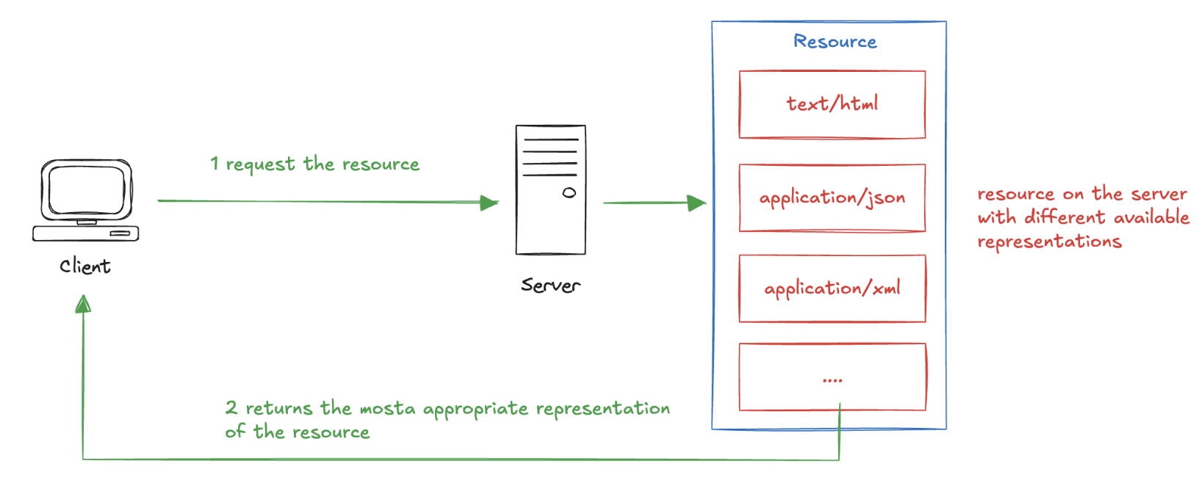
Content Negotiation
Mechanism to ask for a specific type or representation by a client
“Accept” header in the request
specify the desired representation
is possible to have multiple values, with ratings
The server will supply the version of the resource that best fits the user needs
Example:
Accept: application/json; q=1.0, application/xml; q=0.8, */*; q=0.1
ask a JSON format, if it can’t, perhaps it could return XML format (the second level), If it’s still not possible, let it return what it can...

Slide 11
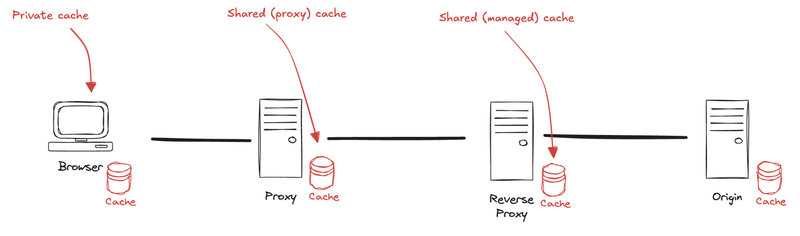
Caches (1)
To eliminate the need to send requests in many cases, and to eliminate the need to send full responses in many other cases
Client-side caching:
When a client first retrieves cacheable resources (e.g. web page) those resources are stored in the local cache
On subsequent visits, the client loads the cached resources from local storage instead of downloading them again from the origin server
Can be private: dedicated to a single user: Cache-Control: private
Server-side caching:
Relies on intermediate nodes or alternative server to store responses from the origin
Lower server load and decreases overall request latency
Common example: reverse proxy (e.g. NGINX)
This type of cache is typically shared: Cache-Control: public

Slide 12
Caches (2)
Cache-Control header
Directives to specify the caching behaviour
no-cache directive: revalidate a stored response with the origin before serving it
no-store: to prevent the response from being stored in any cache
max-age directive: how long a response remains fresh (in seconds from the moment it is generated)
max-stale directive a client can specify that it will accept stale responses for a certain number of seconds beyond their expiration. Useful when the origin is temporarily unavailable
Several other directives: min-fresh, must-revalidate, and proxy-revalidate, additional flexibility in managing cache lifetimes
Expires header
Absolute date and time after which the response is considered stale (in GMT format)
Older caching mechanism, largely replaced by the Cache-Control header

Slide 13
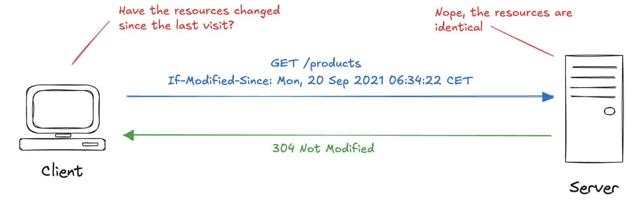
Conditionals (1)
Request a resource only if certain conditions are met
Avoid unnecessary data transfer
Specified through headers that compare the current state of the resource with the version stored by the cache.
improve efficiency by reducing bandwidth usage
Last-Modified header
The date and time that the server believes the resource was last modified
The client can include a If-Modified-Since header

Slide 14
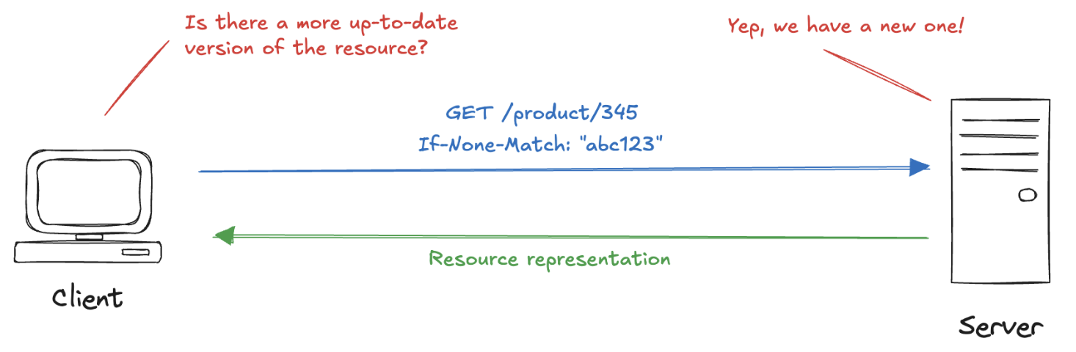
Conditionals (2)
ETag (Entity Tag) header
Used to provide a unique identifier for a specific version of a resource
Acts as a fingerprint for the content, allowing caches and clients to efficiently determine if the content has changed since the last request
On subsequent requests, the client sends the ETag value in the If-None-Match header

Slide 15
Authentication (1)
The process by which a server verifies the identity of a client before granting access to protected resources
Ensures only authorized users can access specific content or perform certain actions.
Basic Authentication
The client sends the username and password in the Authorization header as a base64-encoded string
Digest Authentication
Improves security by hashing the password before sending it over the network
Bearer Token Authentication
The client uses an access token instead of a password
The token can be scoped to specific actions or resources and have expiration times**, adding a layer of security
Certificate-Based Authentication
The client uses a digital certificate to authenticate itself to the server
The server verifies the client's certificate through a trusted certificate authority
Server response:
401 Unauthorized to promp the client to authenticate
Includes a WWW-Authenticate header specifying the authentication methods

Slide 16
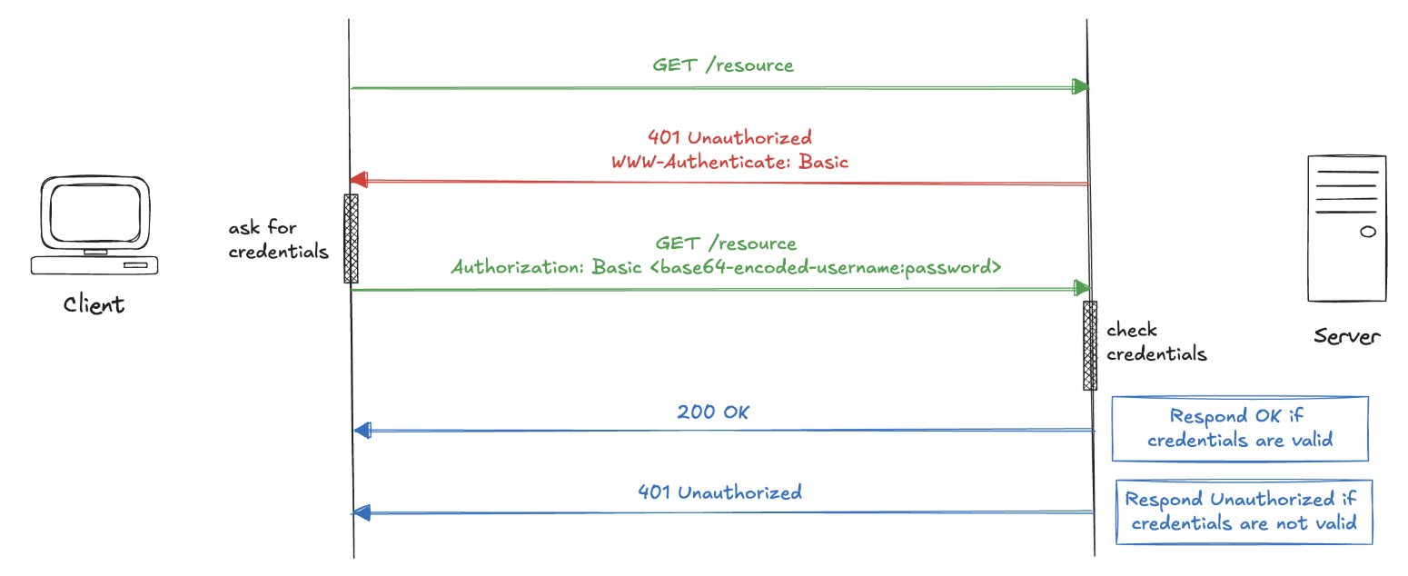
Authentication (2)

Slide 17
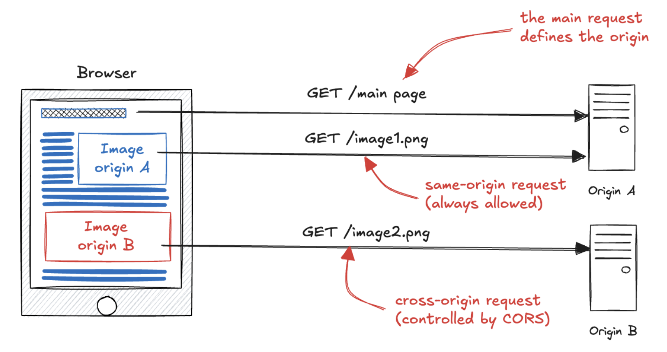
Cross-Origin Resource Sharing (CORS) (1)
Browsers enforce a same-origin policy to restrict how scripts and resources from one origin can interact with resources from another
we browse "www.wikipedia.org" and try to fetch from "www.google.com": the browser will abort the request: This is help to protect privacy.
There are legitimate use cases
an app hosted on one domain wants to fetch data from a service on another domain

Slide 18
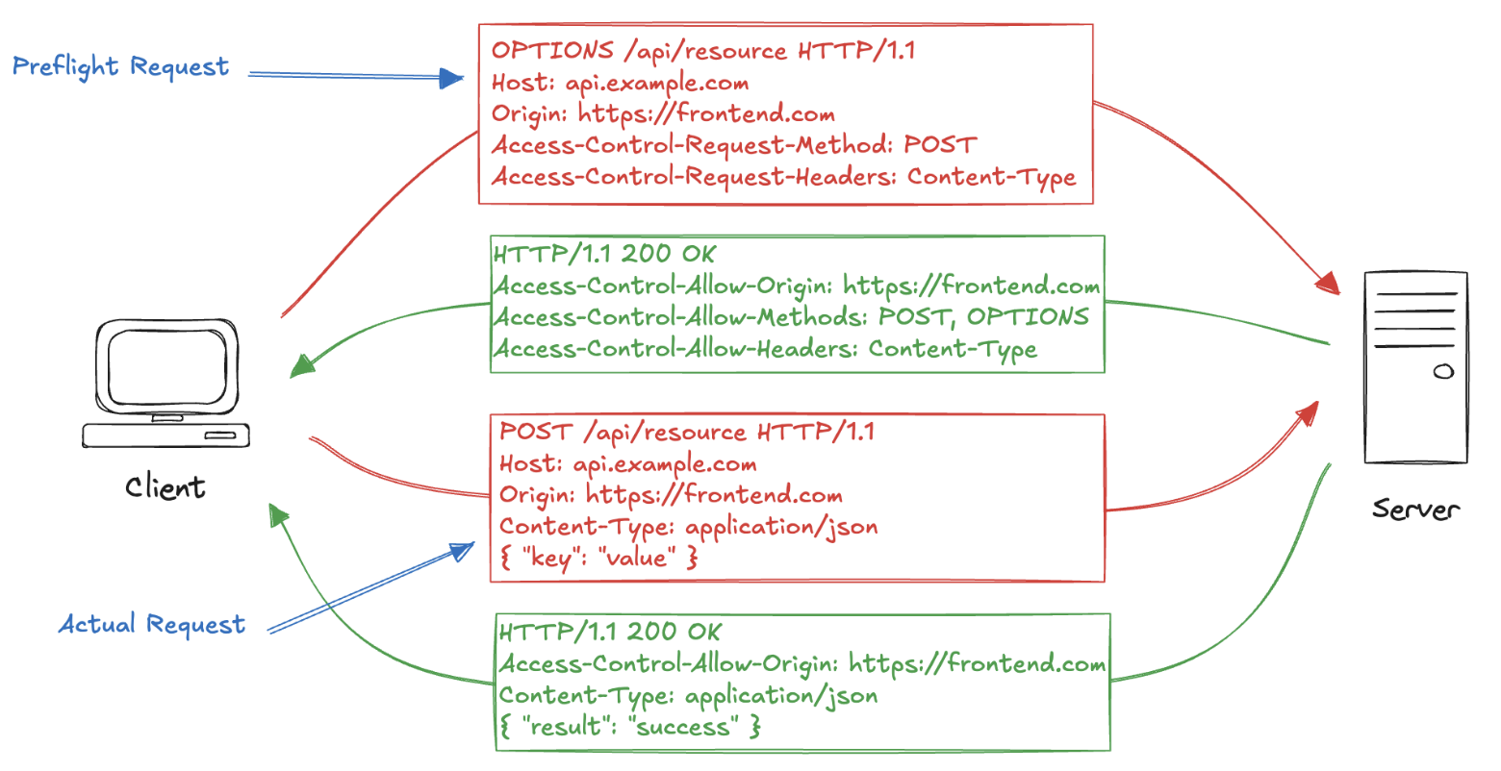
Cross-Origin Resource Sharing (CORS) (2)
Access-Control-Allow-Origin header
The server can specify which origins are permitted to access their resources
When set to **\***, it allows requests from any origin, making the resource publicly accessible, which is useful for open APIs
CORS involves several other request and response headers that regulate how resources are shared

Slide 19
JSON
JavaScript Object Notation (JSON)
easy to read and write both for human and machine
open-standard file format
https://tools.ietf.org/html/rfc8259
Basic syntax
data is represented in “name : value” pairs
the name/value pairs are separated by comma
types: number, string, boolean, object, array, null
curly braces hold objects
square brackets holds array
Serialization/deserialization
from a JSON string to language (Java/C#/Javascript) object
in JavaScript, you can easily parse JSON data using the JSON.parse() method
parses the string and constructs the JavaScript object described by the string
// Store JSON data in a JS variable
let json = '{"name": "Peter", "age": 22, "country": "United States"}';
// Converting JSON-encoded string to JS object
let obj = JSON.parse(json);
// Accessing individual value from JS object
console.log(obj.name);

Slide 20
HTTP and the Browser
A browser will make a GET request on the URL in its address bar
If the resulting HTML references other files (e.g. images, JS files, etc.) then the browser will GET also these resources simultaneously
HTML page can include forms to build method requests:
<form method="GET" action="example/message.html">
<p>Name: <input type="text" name="name"</p>
<p>Message: <textarea name="message"></textarea></p>
<p><button type="submit">Send</button></p>
</form>
When the button is pressed, the information in the fields are encoded into a query string and the form method (here GET) is requested:
GET /example/message.html?name=Jean&message=Yes HTTP/1.1
A button
Two fields (text and textarea)
Query string, it starts with a question marks, then follow pairs of “name=value” separated by &

Slide 21
HTTP and the Browser
If we change the method in the form with POST
the request will use POST
the query string will be moved in the body
POST /example/message.html HTTP/1.1
Content-length: 24
Content-type: application/x-www-form-urlencoded
name=Jean&message=Yes
Important HTTP conventions:
GET is used for request that do not have side effects (e.g. doing a search)
safe and idempotent (can be applied multiple times without changing the result)
POST is used for request that change something on the server (e.g. posting a message)
non-safe and non-idempotent
Browsers can make HTTP request from JS with XMLHttpRequest()
designed by Microsoft in 90s (when XML was very popular)
bad design: it confuse two distinct concepts (making a request and parsing the response)
See 01.HTTPRequest.js

Slide 22
Asynchronous Requests
Synchronous requests block the execution of code which creates "freezing" (e.g. unresponsive user experience)
when connection is bad, the server is slow and the file is big…
XMLHttpRequest() supports also asynchronous communications
See 02.AsyncHTTPRequest.js
When we call “send” the request gets scheduled to be sent
the program can continue
the browser will take care of the sending and receiving of data in the background
but as long as the request is running, we won’t be able to access the response
We must listen for the "load" event on the request object
Asynchronous style of programming
wrapping the things that have to be done after the request in a function
arranging for that to be called at the appropriate time
Today XMLHttpRequest is outdated and has been replaced by the Fetch API, which provides a more modern and flexible way to interact with HTTP resources
It is promise-based making it easier to work with asynchronous requests.
See 03.FetchAPI.js

Slide 23
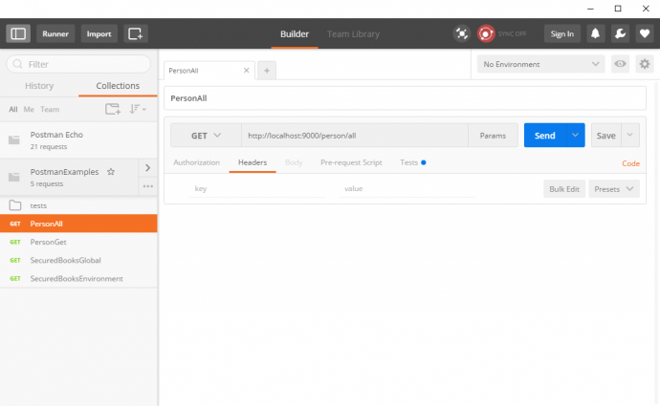
Postman
An application used to fire HTTP requests
lightweight and fast
requests can be organized in groups
tests can be created with verifications for certain conditions on the response
Support HTTP
different kinds of HTTP requests (GET, POST, PUT, PATCH and DELETE)
add headers to the requests
More interesting features:
variables
pre-request script
tests

Slide 24
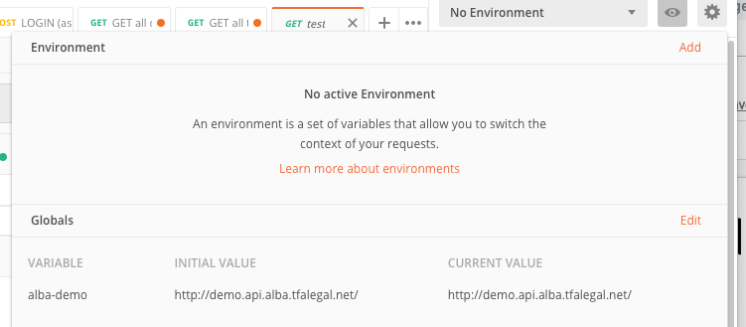
Postman: variables
Two types of variables: global and environment
global variables are for all requests
environment variables are defined per specific environment
selected from a drop-down
Editable by a small eye-shaped icon in the top right corner
Once defined variables can be used in a request with format surrounded by curly brackets {{VARIABLE_NAME}}
Example: set a variable “url” with value “https://jsonplaceholder.typicode.com”

Slide 25
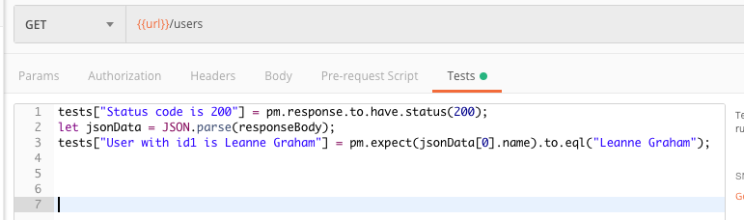
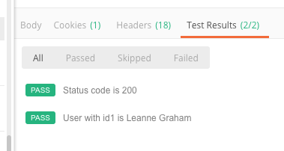
Postman: Tests
After a response is received, Postman has a functionality to make verifications on it
done in “Tests” tab
JSON response can be parsed and properties accessed by some JavaScript code
Test are written in the format
tests[“TEST_NAME”] = BOOLEAN_CONDITION
Example:
make GET over “{{url}}/users
check if the status code is 200
Check if the list of user contains a specific user

Slide 26
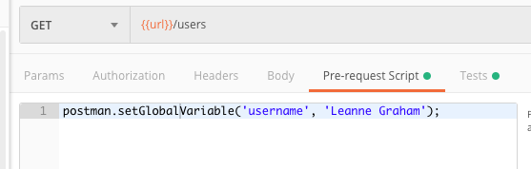
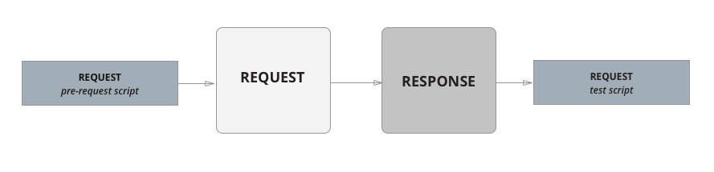
Postman: Pre-Request Script
To do JavaScript coding to manipulate the data being sent with the request

Slide 27
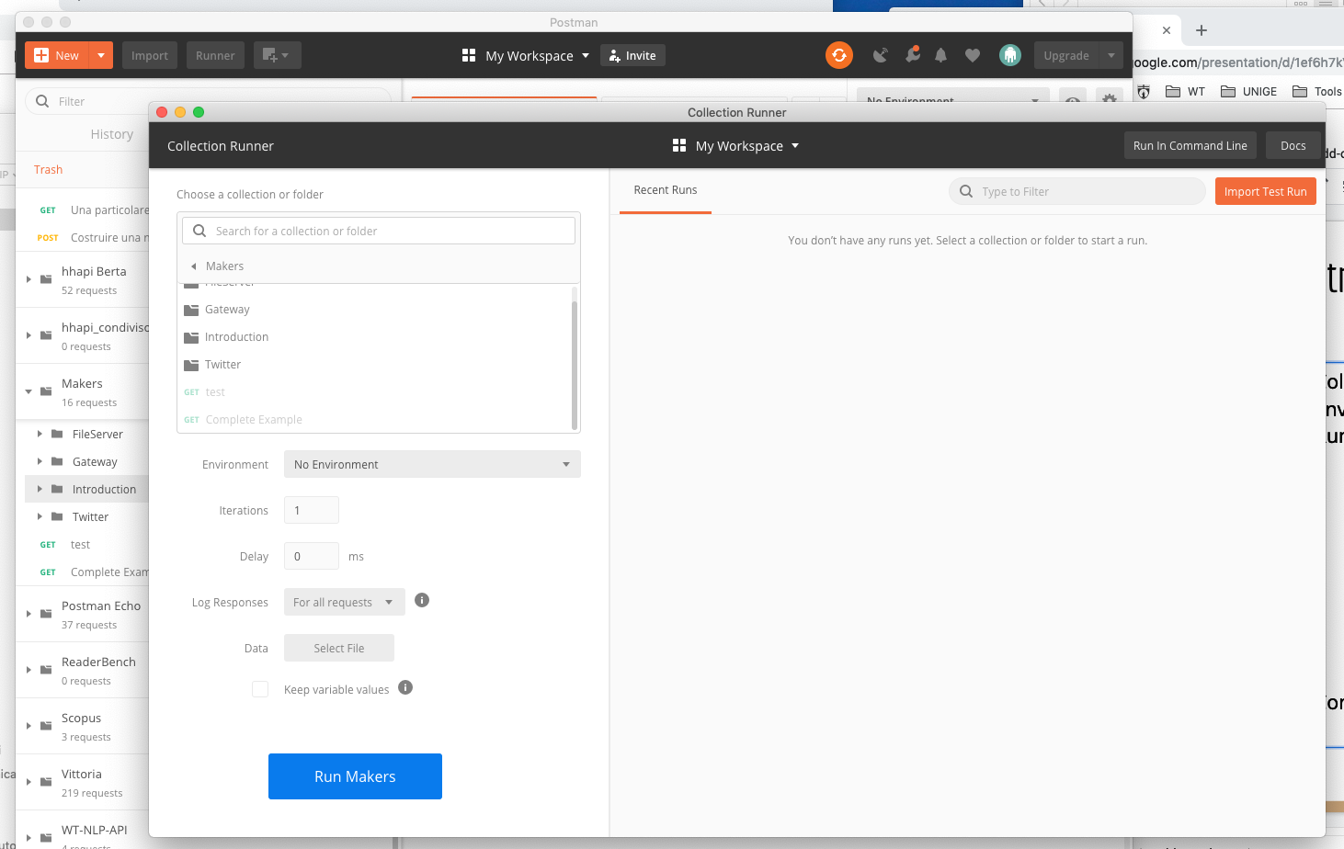
Postman: more...
Collections
Environment
Runner
Complete example: 0.3.Makers.postman_collection.json

Slide 28
Hands-on Activity
Create a Postman collection to test the API that you can find at the following link https://jsonplaceholder.typicode.com/. You have to post some “comments” and get a list of previous “posts”

